Slide 1
HPC – Proyecto 03
Problema del viajero

Slide 2
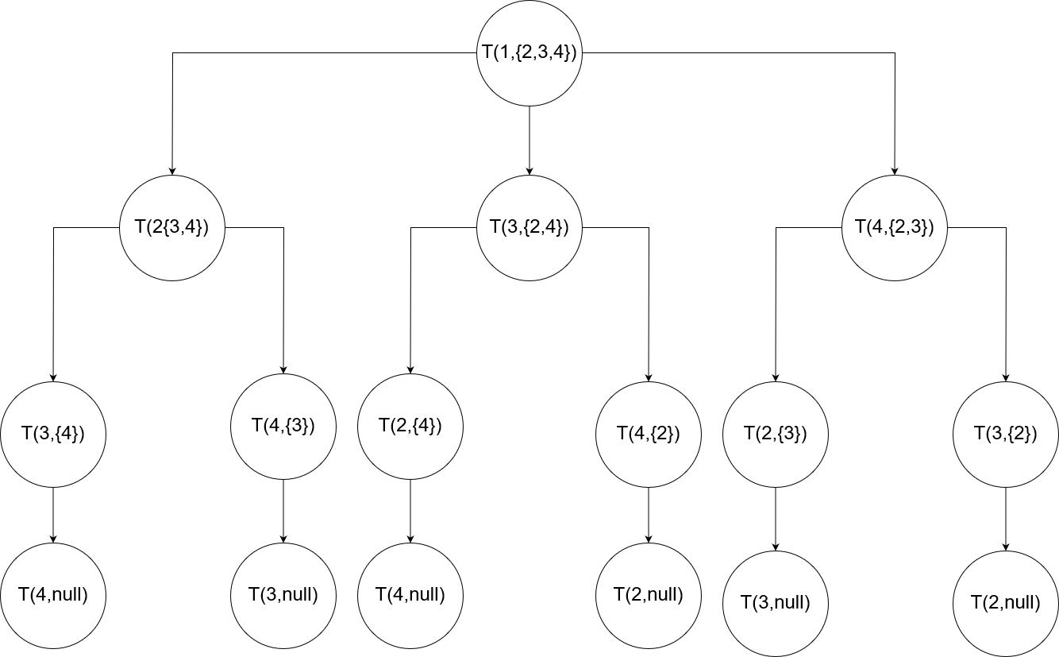

Slide 3
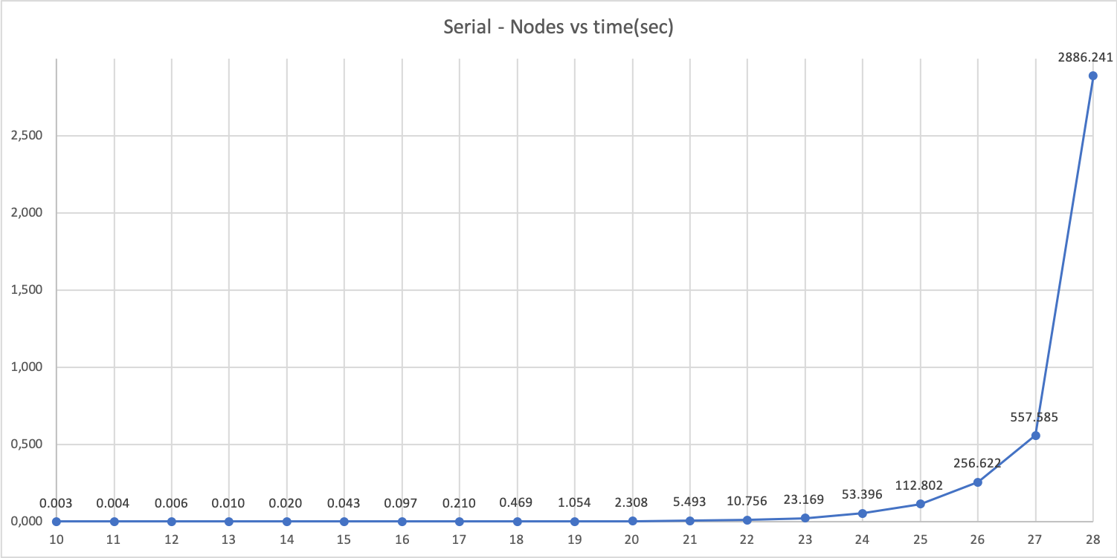
Tiempos Serial
nodes | time(sec)
10 | 0,003
11 | 0,004
12 | 0,006
13 | 0,010
14 | 0,020
15 | 0,043
16 | 0,097
17 | 0,210
18 | 0,469
19 | 1,054
20 | 2,308
21 | 5,493
22 | 10,756
23 | 23,169
24 | 53,396
25 | 112,802
26 | 256,622
27 | 557,585
28 | 2886,241

Slide 4
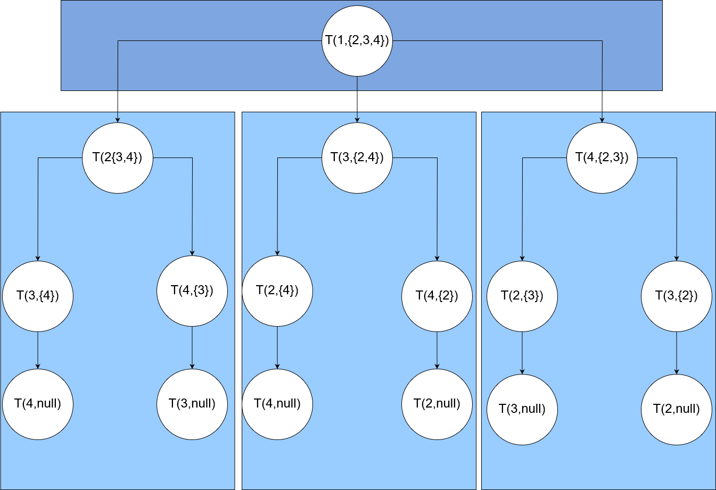

Slide 5
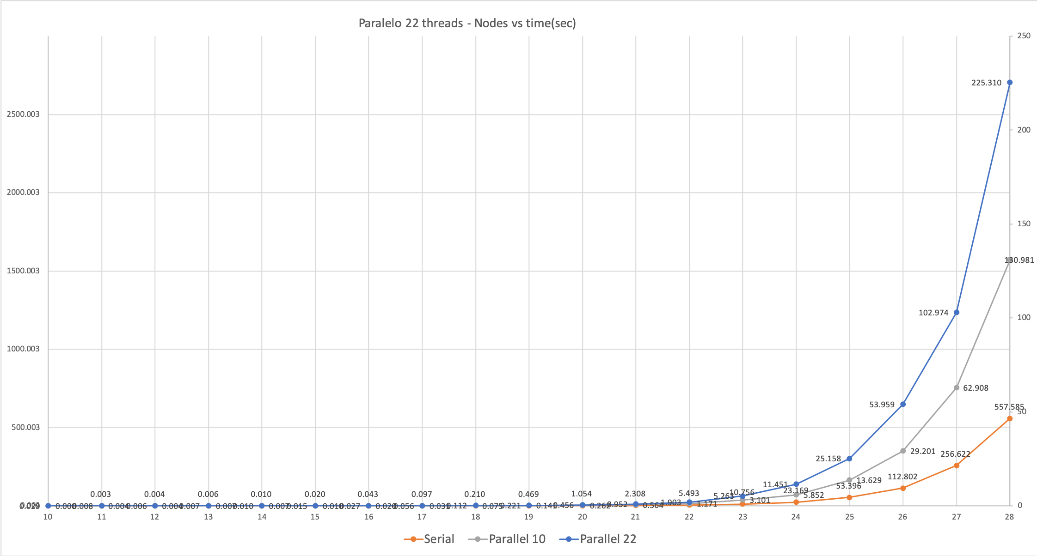

Slide 6
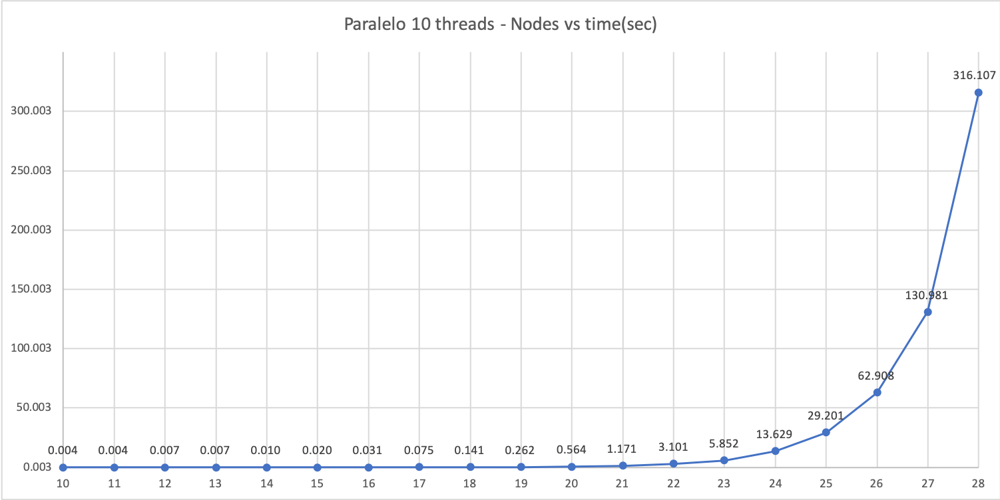
Tiempo Paralelo 10 Hilos
nodes | time(sec)
10 | 0,004
11 | 0,004
12 | 0,007
13 | 0,007
14 | 0,010
15 | 0,020
16 | 0,031
17 | 0,075
18 | 0,141
19 | 0,262
20 | 0,564
21 | 1,171
22 | 3,101
23 | 5,852
24 | 13,629
25 | 29,201
26 | 62,908
27 | 130,981
28 | 316,107

Slide 7
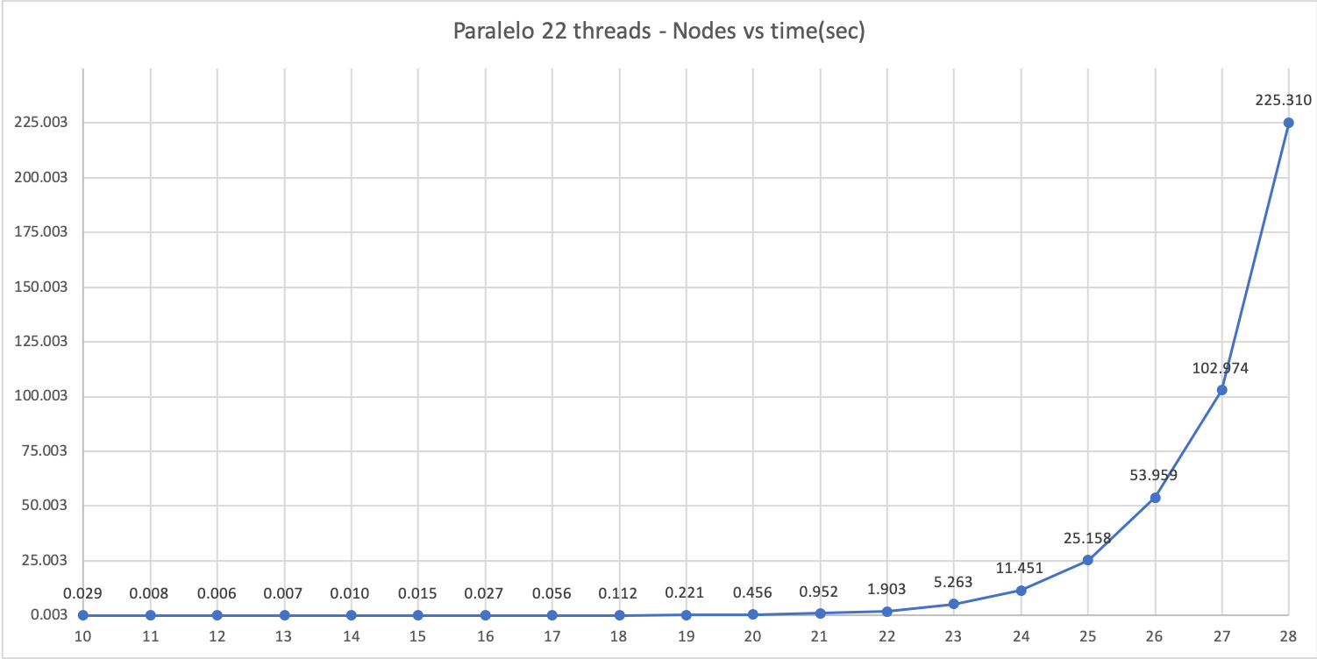
Tiempo Paralelo 22 Hilos
nodes | time(sec)
10 | 0,029
11 | 0,008
12 | 0,006
13 | 0,007
14 | 0,010
15 | 0,015
16 | 0,027
17 | 0,056
18 | 0,112
19 | 0,221
20 | 0,456
21 | 0,952
22 | 1,903
23 | 5,263
24 | 11,451
25 | 25,158
26 | 53,959
27 | 102,974
28 | 225,310

Slide 8
Mediciones
Speed Up
Efficiency
T_{s}
S
S=
E=
T_{p}
p
S = Speed up
T_{s} = Tiempo serial
T_{p} = Tiempo paralelo
E = Efficiency
S = Speed up
P = number of processors

Slide 9
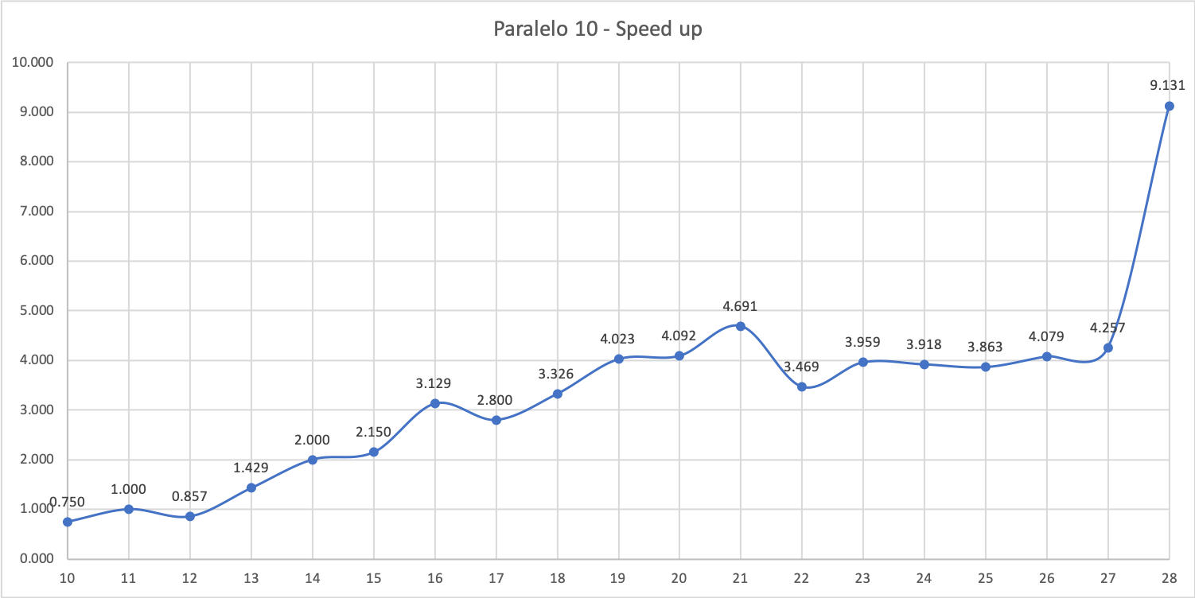
Speed up Paralelo 10 Hilos
nodes | Speed up
10 | 0,750
11 | 1,000
12 | 0,857
13 | 1,429
14 | 2,000
15 | 2,150
16 | 3,129
17 | 2,800
18 | 3,326
19 | 4,023
20 | 4,092
21 | 4,691
22 | 3,469
23 | 3,959
24 | 3,918
25 | 3,863
26 | 4,079
27 | 4,257
28 | 9,131

Slide 10
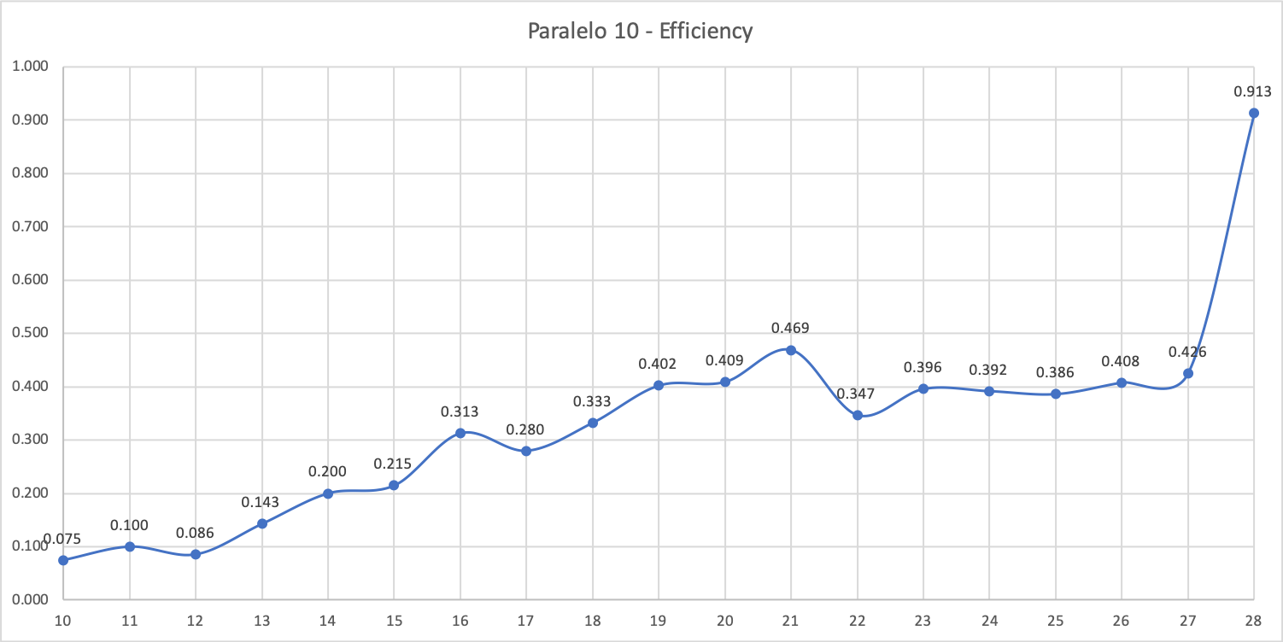
Eficiencia Paralelo 10 Hilos
nodes | Efficiency
10 | 0,075
11 | 0,100
12 | 0,086
13 | 0,143
14 | 0,200
15 | 0,215
16 | 0,313
17 | 0,280
18 | 0,333
19 | 0,402
20 | 0,409
21 | 0,469
22 | 0,347
23 | 0,396
24 | 0,392
25 | 0,386
26 | 0,408
27 | 0,426
28 | 0,913

Slide 11
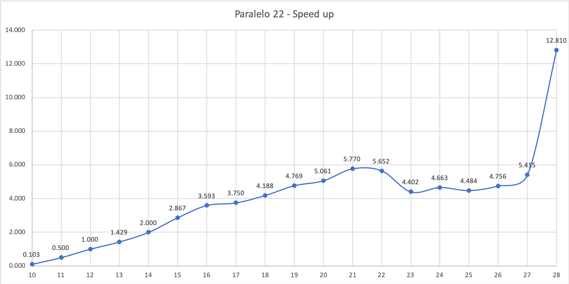
Speed up Paralelo 22 Hilos
nodes | Speed up
10 | 0,103
11 | 0,500
12 | 1,000
13 | 1,429
14 | 2,000
15 | 2,867
16 | 3,593
17 | 3,750
18 | 4,188
19 | 4,769
20 | 5,061
21 | 5,770
22 | 5,652
23 | 4,402
24 | 4,663
25 | 4,484
26 | 4,756
27 | 5,415
28 | 12,810

Slide 12
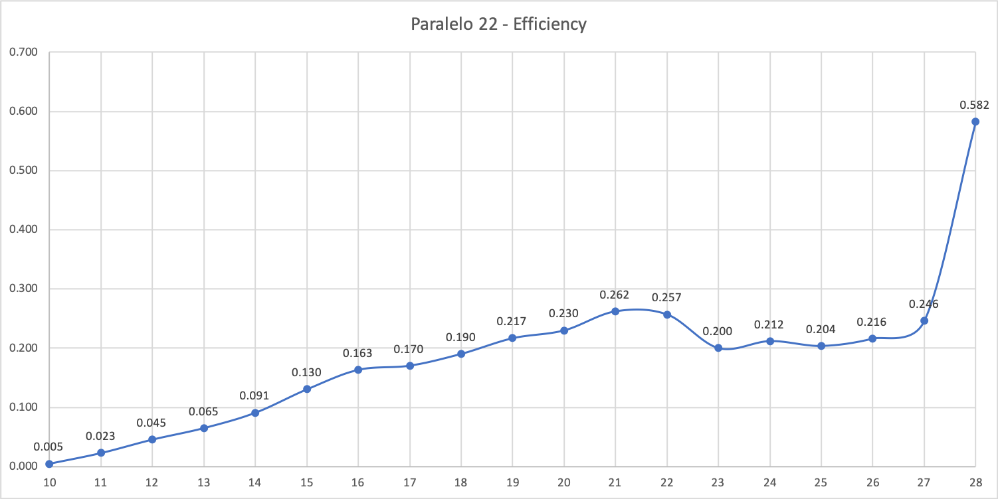
Eficiencia Paralelo 22 Hilos
nodes | Efficiency
10 | 0,005
11 | 0,023
12 | 0,045
13 | 0,065
14 | 0,091
15 | 0,130
16 | 0,163
17 | 0,170
18 | 0,190
19 | 0,217
20 | 0,230
21 | 0,262
22 | 0,257
23 | 0,200
24 | 0,212
25 | 0,204
26 | 0,216
27 | 0,246
28 | 0,582

